Slide 1

MONEY TAP : BRAND POSITIONING & ARCHITECTURE FOR A FINTECH STARTUP BRAND​
GROUP X5
Gezatan Nimal Raj (MBA202325-081)
R. Kuberan (MBA202325-165)
K Muhammed Dawood Khalid (MBA202325-120)
Jeby Raja Jesura (MBA202325- 092)
Raksha jaiswal (MBA202325- 173)
Niyati Reddy (MBA202325- 137)

Slide 2
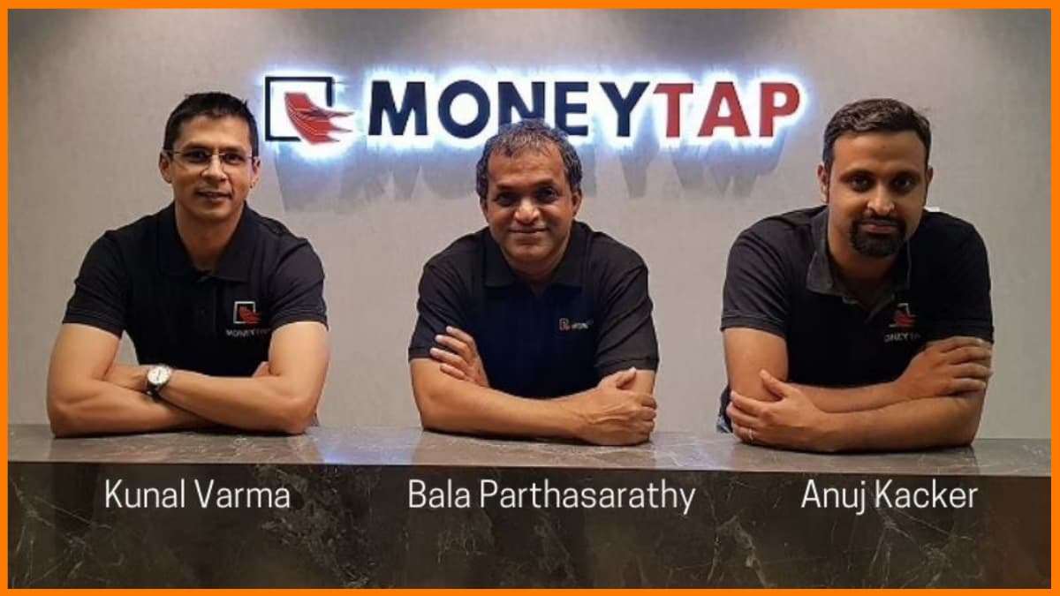
Notes:
The above three are the co-founders of the app based credit line company Money Tap.
Bala Parthasarathy has done his Bachelors IIT Madras and went onto pursue his masters in Computer Engineering from the University Of Califiornia. He is the Co-Founder of SnapFish and is the Managing Partner of Prime Ventures.
Kunal Verma has done is Bachelors Degree from IIT Roorkee and has done an MBA from the Indian School Of Business. He was the founder of Aspirare and was also the CEO of TapStart.
Anuj Kacker has done his Bachelors in B.s.c Mathemetics from St Xavier's College. He's also done his MBA from the Indian School Of Business. He was the DGM Head of acquisitions & Mobile Internet and was also the co-founder of TapStart.

Slide 3
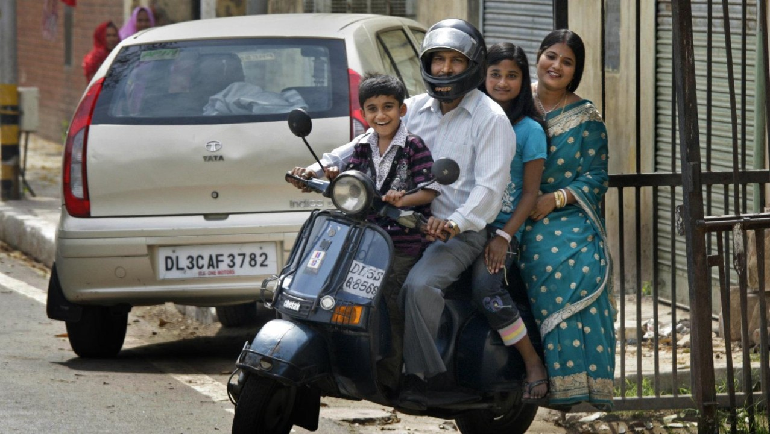

Notes:
They are into the lending business, Ideology of the business is penetrating into middle class segment and fulfilling desires, wants and needs

Slide 4

Notes:
The problem arises with money tap when they want to become a full stack neo bank, as they were shifting their focus from a single product to multiple product offering they needed to change brand architecture with an overarching brand

Slide 5
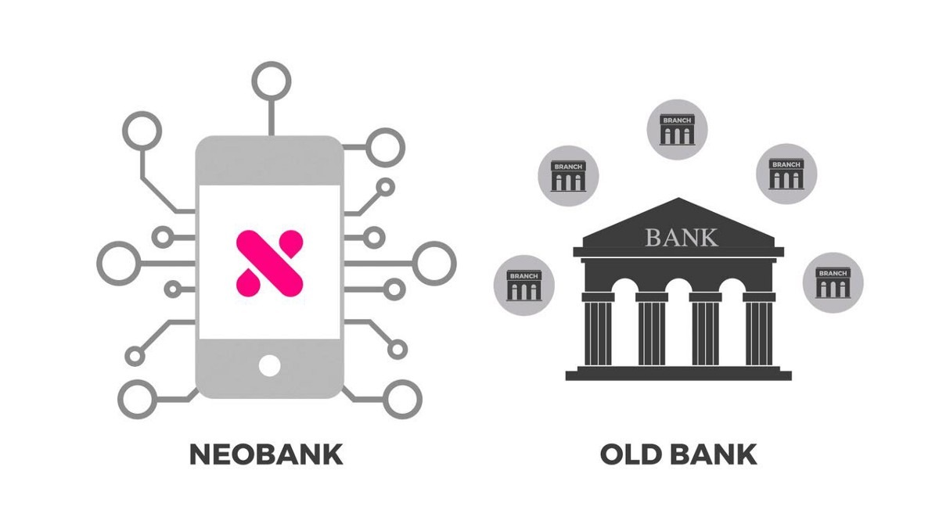
Notes:
Neobanks are only digital and they don't occupy any physical space to operate. Traditional Banks on the other hand operate through a physical Branch and use online platforms for convenience and better connectivity.
NeoBanks usually partner with liceneced banks to operate. This is usually because NeoBanks are not directly regulated by the Reserve Bank Of India. Traditional banks on the other hand hold their own banking licences and are regulated by the RBI.
NeoBanks usually focus on core banking services, wherease traditional banks have a wider range of products like insurance, investments etc.

Slide 6


3 Positioning Strategies
Revolutionize Access
Impact through Actions
Freedom to fulfil dreams
Notes:
When Money tap was seeking help for a new brand strategy L&F India (Mr. Lulu Raghavan) comes up with 3 positioning concepts based on its analysis. We think impact through actions is the right choice to go ahead as this strategy focuses on the credit new bies and big dreamers. As the stats denotes that the neo banking is going to increase by $USD 333.4 billion and mobile penetration is expected to increase from 47.1% to 96% by 2040 which means there are going to be more density credit new bies. So choosing this strategy will be more impactful than the other two as it focuses more on credit new bies and big dreamers segmentations. Additionally considering the dynamic change in consumer expectations especially among the younger demographic segments understanding the consumer and providing personalized financial solutions will build trust and loyalty

Slide 7









Competitors

Slide 8
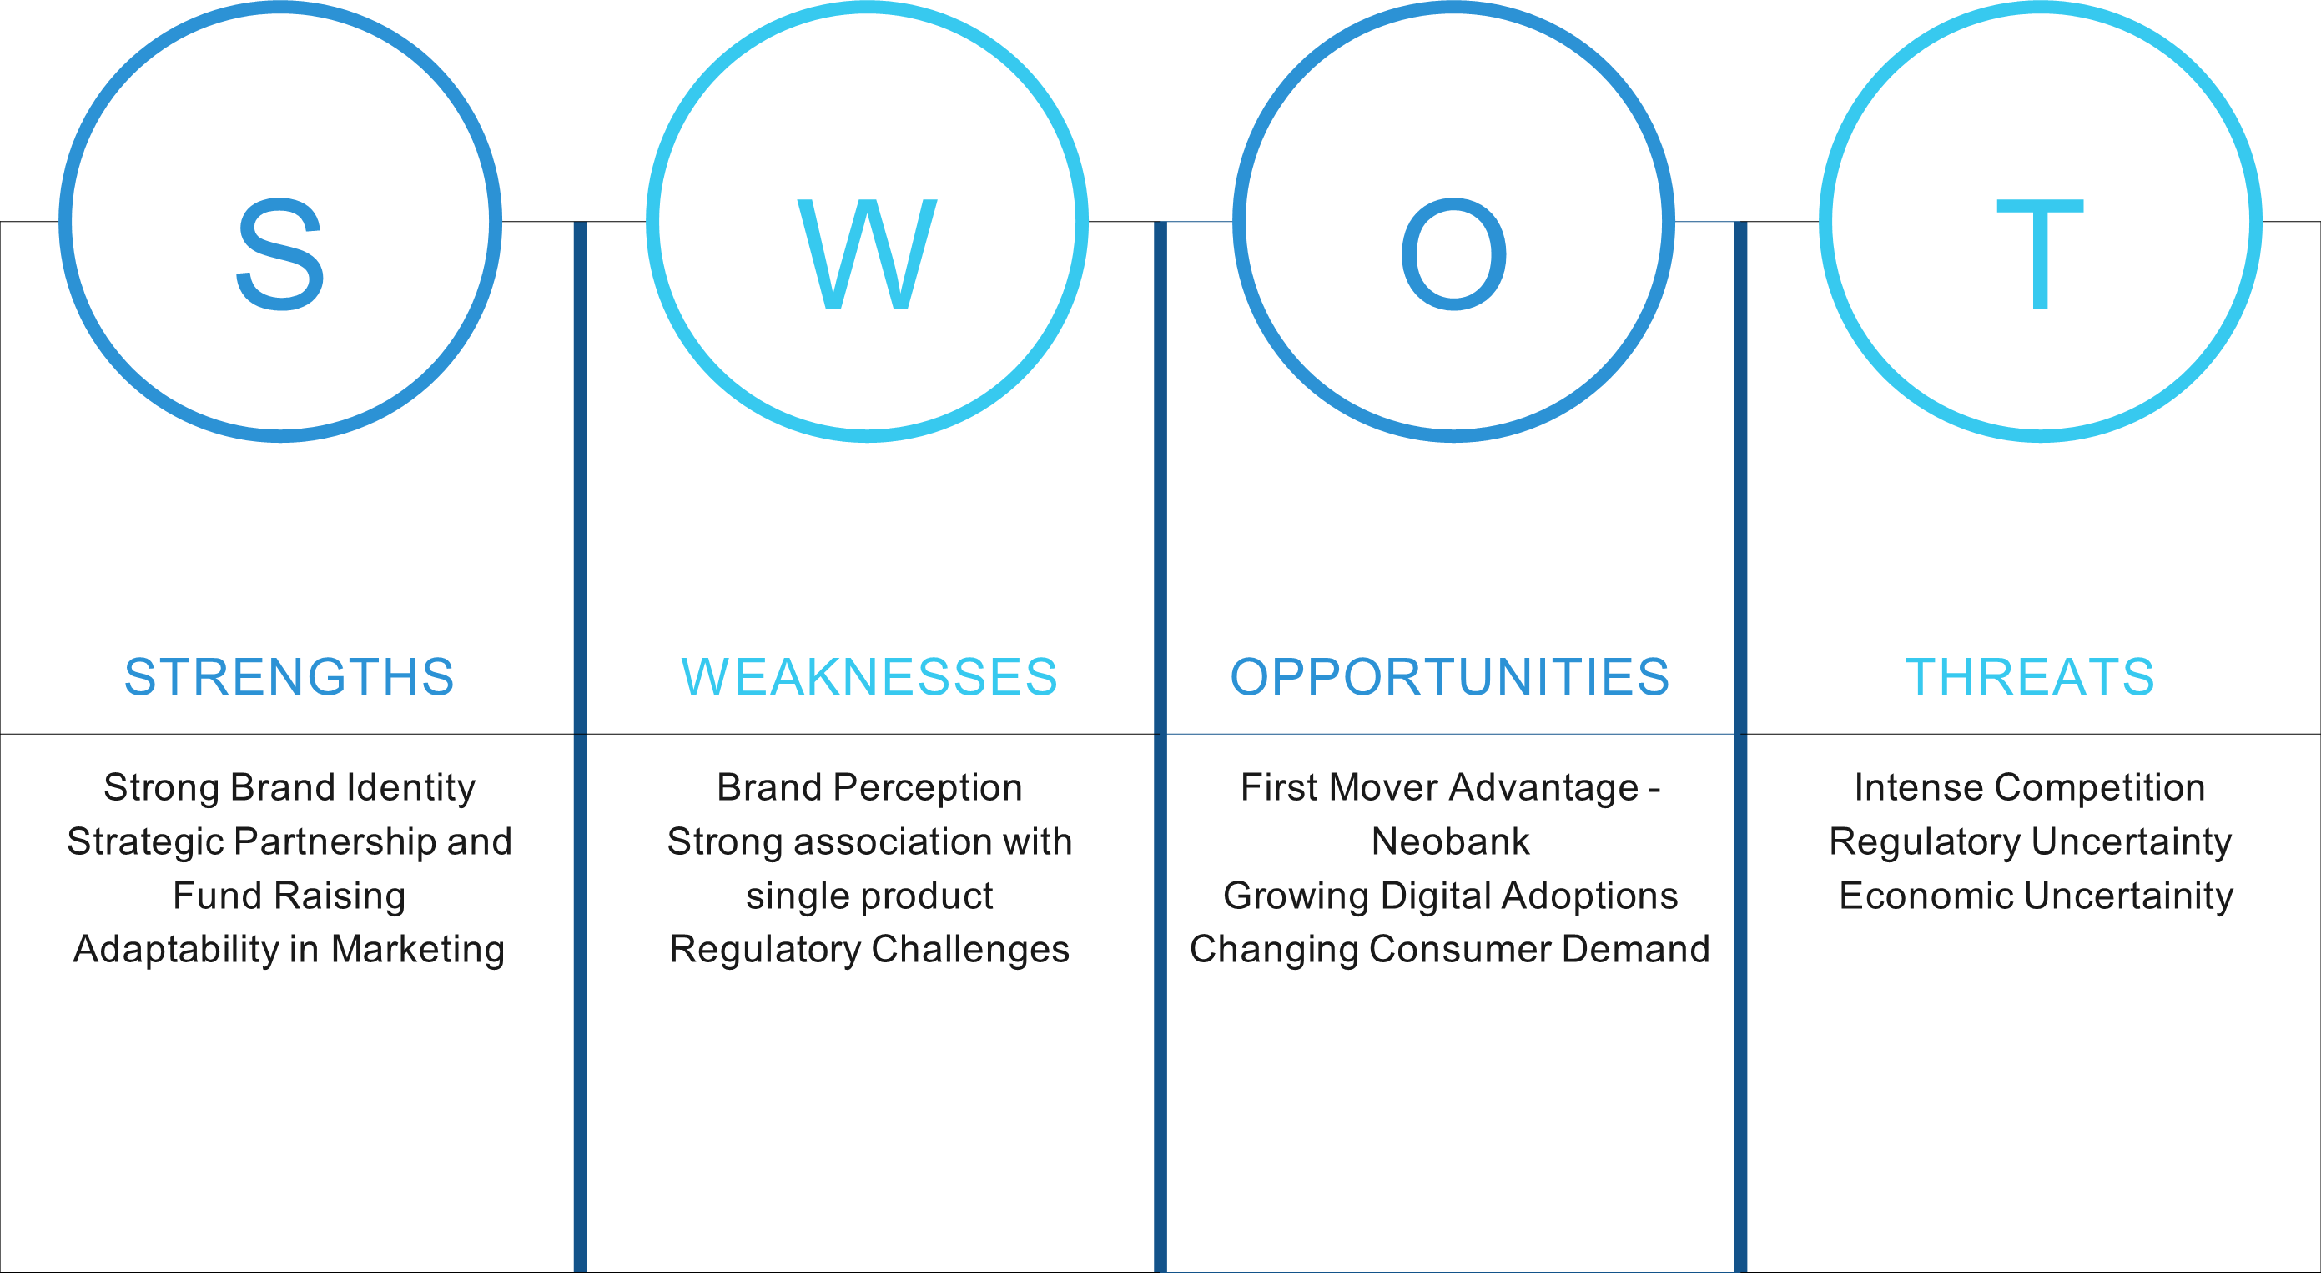
Notes:
Strength –
Brand Identity - The MoneyTap brand has a strong association with its credit line product, indicating a well-established brand identity in the market.
Strategic Partnership and Fund raising - MoneyTap has garnered the support of prominent investors like Sequoia India, Prime Venture Partners, RTP Global and more, which provides not only capital but also adds credibility and stability to the venture
Adaptability in Marketing: MoneyTap's shift from mass campaigns to personalized online campaigns significantly improved lead generation, and application, which resulted in 10 times increased in disbursement within 3 years.
Weakness
Brand Perception - The company is perceived as an app-startup rather than financial institution which led to less credibility for the MoneyTap as a brand.
Strong association with single product – The company is perceived primarily as a credit provider,which could hinder diversification efforts.
Regulatory Challenges: Operating as a neobank in India presents regulatory challenges, as the Reserve Bank of India does not yet recognize neobanks. This limitation prevents MoneyTap from accepting deposits or offering lending products directly, potentially restricting growth and service offerings
Opportunities
First Mover advantage to become India’s first full stack neobank by expanding offerings by adding a pay-later option, credit cards, and digital savings accounts, hence starting with neobanking services in India which was expected to hit US$333.4billion by 2026 at a CAGR of 47.1%.
Growing digital adoptions – Smartphone penetration was expected to grow to 96% by 2040 and allocation of US$196.6million to boost digital payments in the fintech sector.
Changing consumer demand – Millenials and Gen Xers were more tech-savy and preferred mobile banking services.
Threats
Intense Competition – The market was becoming more saturated with a mix of emerging and established competitors.
Regulatory Uncertainty: The lack of clear regulatory frameworks for neobanks in India poses a threat to MoneyTap’s operations. Regulatory changes or increased scrutiny could impact its ability to offer certain financial products and services.
Economic Uncertainty- Economic downturns, such as those experienced during the COVID-19 pandemic, can impact consumer spending and borrowing behaviors, potentially affecting MoneyTap’s revenue and growth prospects

Slide 9
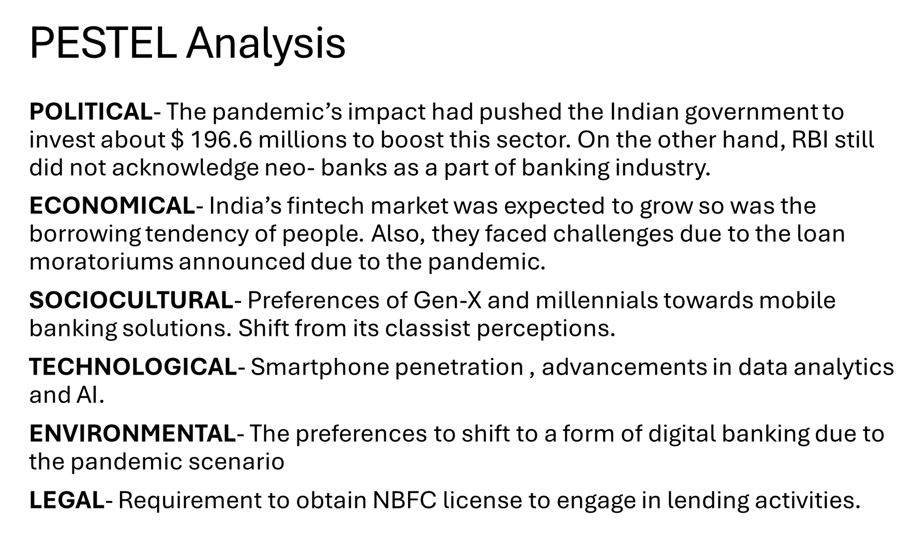

Slide 10
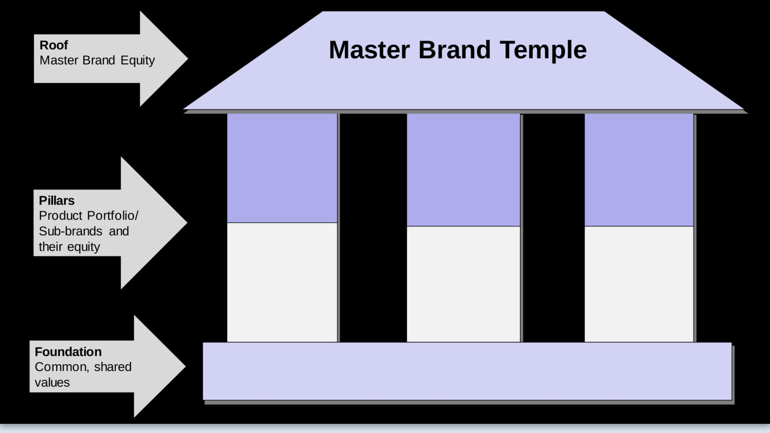

Born different for you- Tailor made financial services
Break down rigidity and Experience financial freedom with convenience and flexibility
Personal credit Line
Savings account
Pay later services
Moneytap’s flagship app based credit line . Credit limit starting from 3000.
Allows existing customers to keep cash in account and helps in ease of loan approval.
This service allows cutomers to buy the product and defer payment
Moneytap’s mobile app helps in seamless experience to track finance.
To empower individuals by innovative financial solutions that cater to their lifestyles and desires.

Slide 11
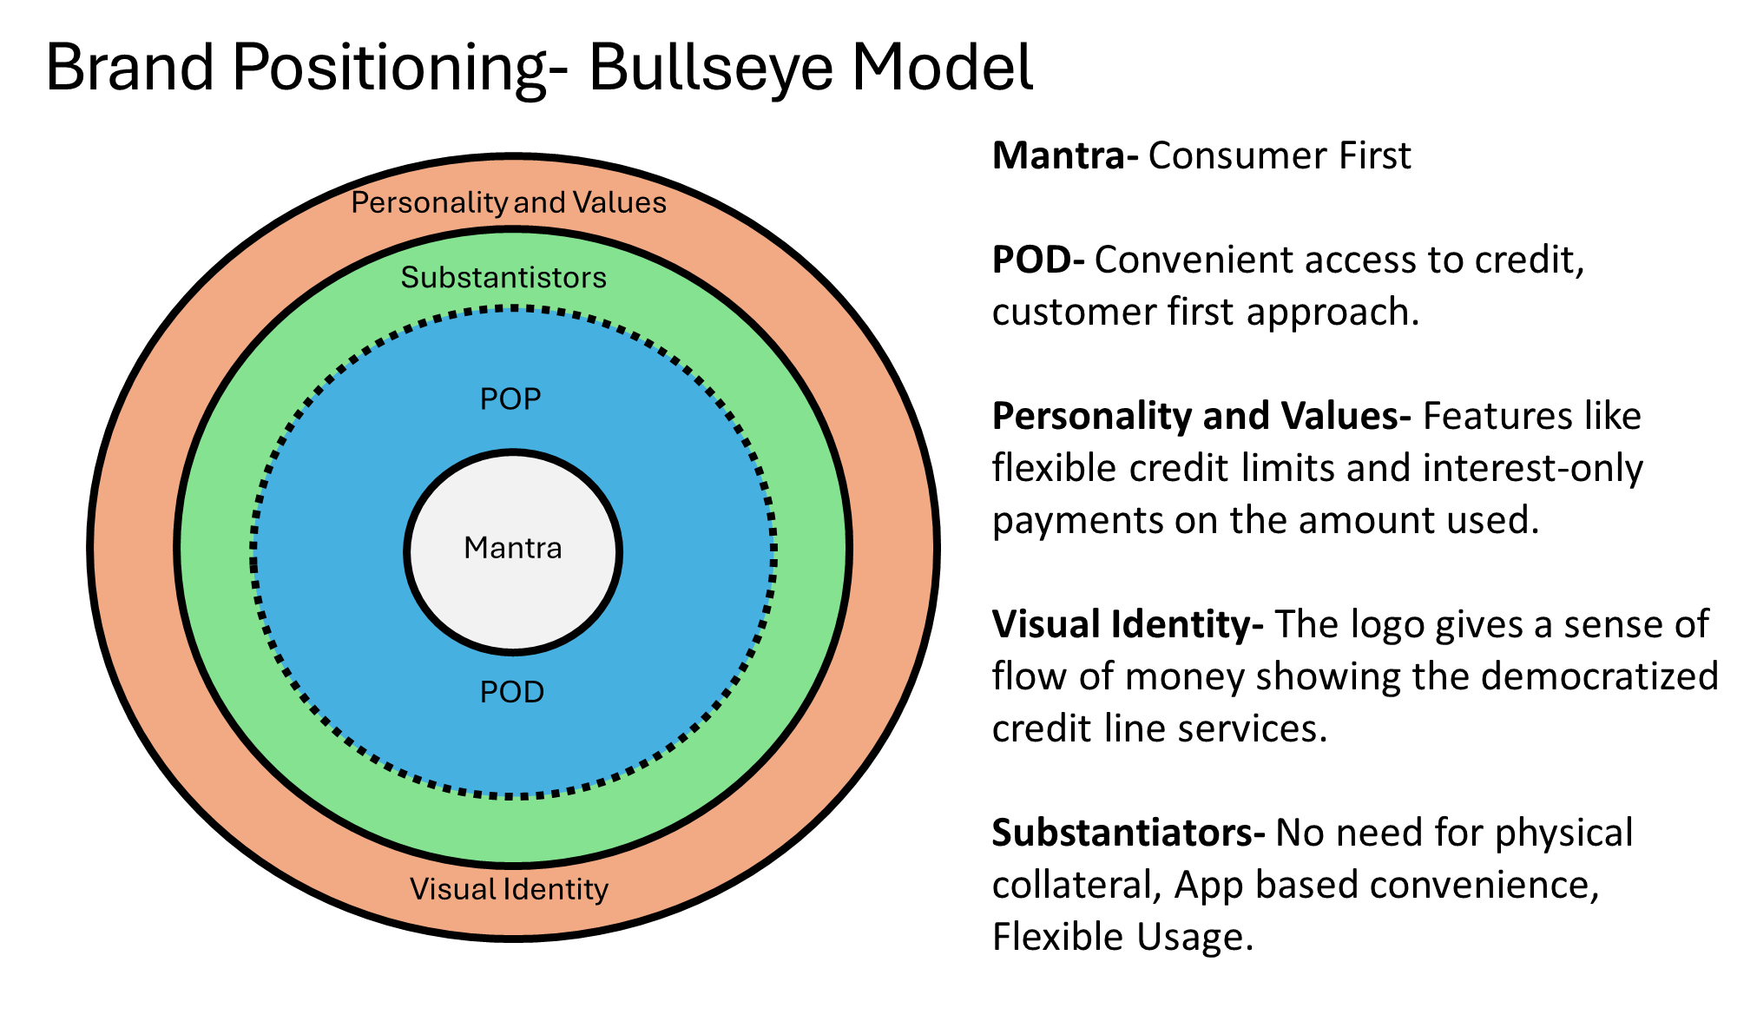
Notes:
This model is by Philip Kotler
Mantra- Brand Essence
POP- Competitors
POD- Competitors
Personality and values- Brand Characteristics
Visual Identity- Brand guidelines
Substantiators- Elements or factors that provides credibility

Slide 12
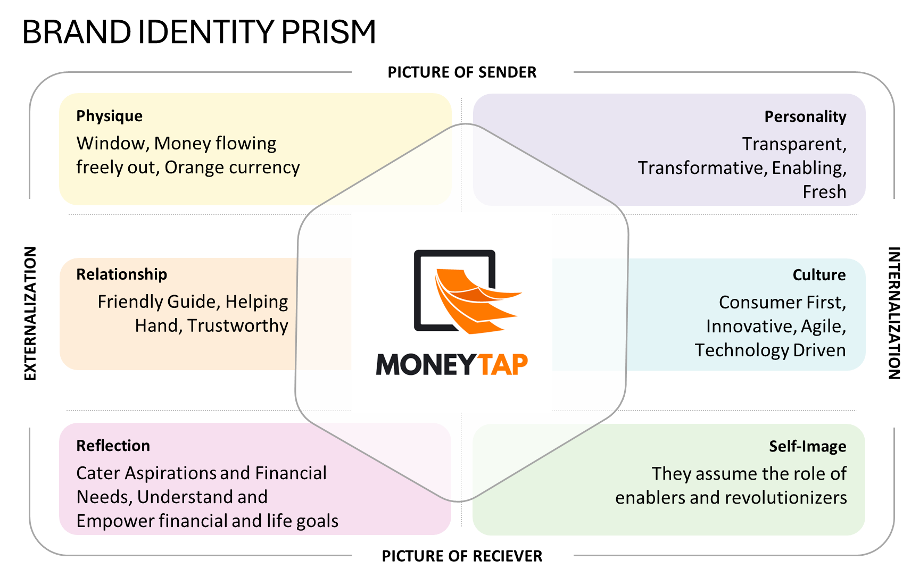

Slide 13
Brand Equity
Awareness
Perception
Loyalty
Association
Brand awareness – The applied brand position strategy increases recognition of the brand as a flexible and customer first financial solution. With social media having a strong impact in influencing, word of mouth will improve awareness of the brand.
Brand Associations- A strong and positive synergy can be created with the tailormade service and customer support. As the brand focuses on understanding the lifestyle and goals, this makes customers feel more engaged with the brand.
Perceived Quality- Positioning Moneytap as a strong source of reliability and efficient alternative for traditional banking system. Moneytap presents a flexible, easy and convenient platform to avail credit .
Brand Loyalty- Customers who got solutions to their financial queries can become more loyal and inclined towards the brand. Customers will be delighted as the brand was a helping hand that understood their actual needs and requirements.
Notes:
Actions for gaining market equity-
Brand awareness- Actively engaging with the customers through social media and create buzz about the brand.
Brand association- Developing keywords that will make the customers relate with the brand. In our brand, It can be tailormade or personal credit, etc.
Perceived quality- Regularly updating the website and apps based on events and customer feedbacks to make it more user friendly.
Brand Loyalty- Creating community engagement platforms to share experiences and to know more about the brands from its customers. Incentivizing repeat customers and referrals.

Slide 14
Brand Pyramid
Brand Idea: The main essence/Idea of the brand is to empower customers by providing easy and quick financial solutions that adapt to their lifestyles.
Brand Persona: Since the brand is going to make an impact through actions their persona revolves around having a customer-first approach and being flexible.
Emotional Benefits: Since the brand is positioning itself around the customer, the emotional benefits that the customers would experience are empowerment, peace of mind and confidence.
Functional Benefits: Some of the functional benefits that the brand possesses include quick and easy transactions, accessible and personalized credit and cost effectiveness.
Features: Some of the distinguishable features include, app-based credit line, Unsecured Credit, Flexible Repayment etc.
Brand Persona
Emotional Benefits
Brand Idea
Functional Benefits
Features

Slide 15
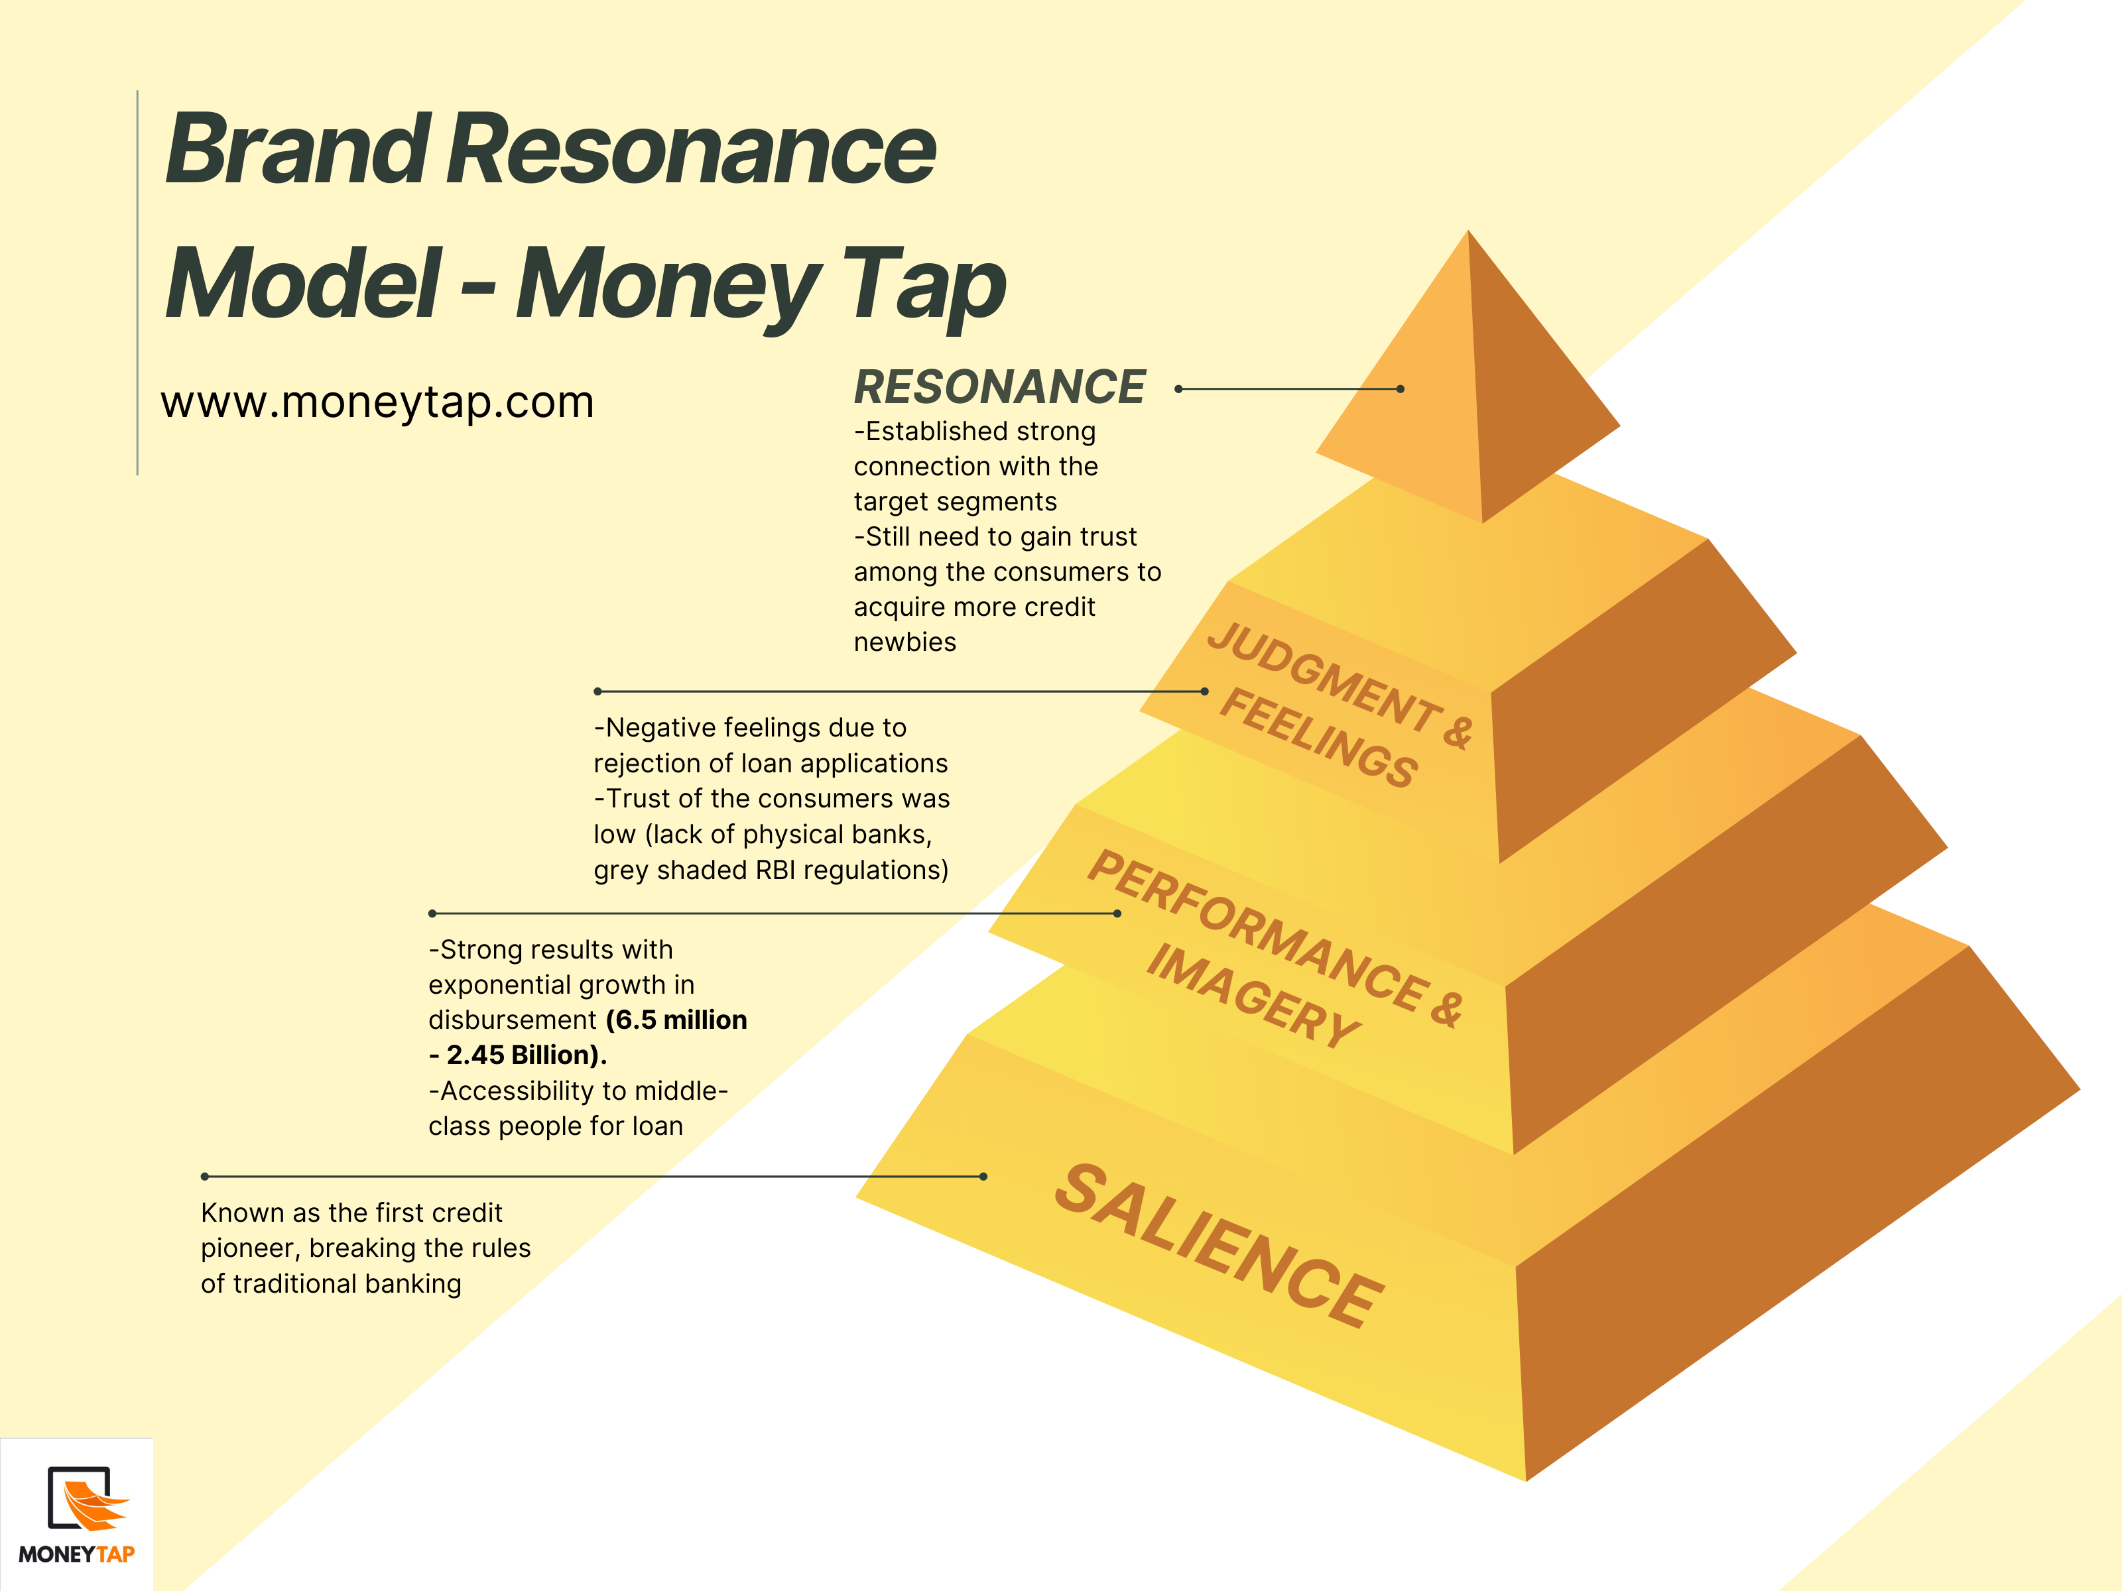

Slide 16
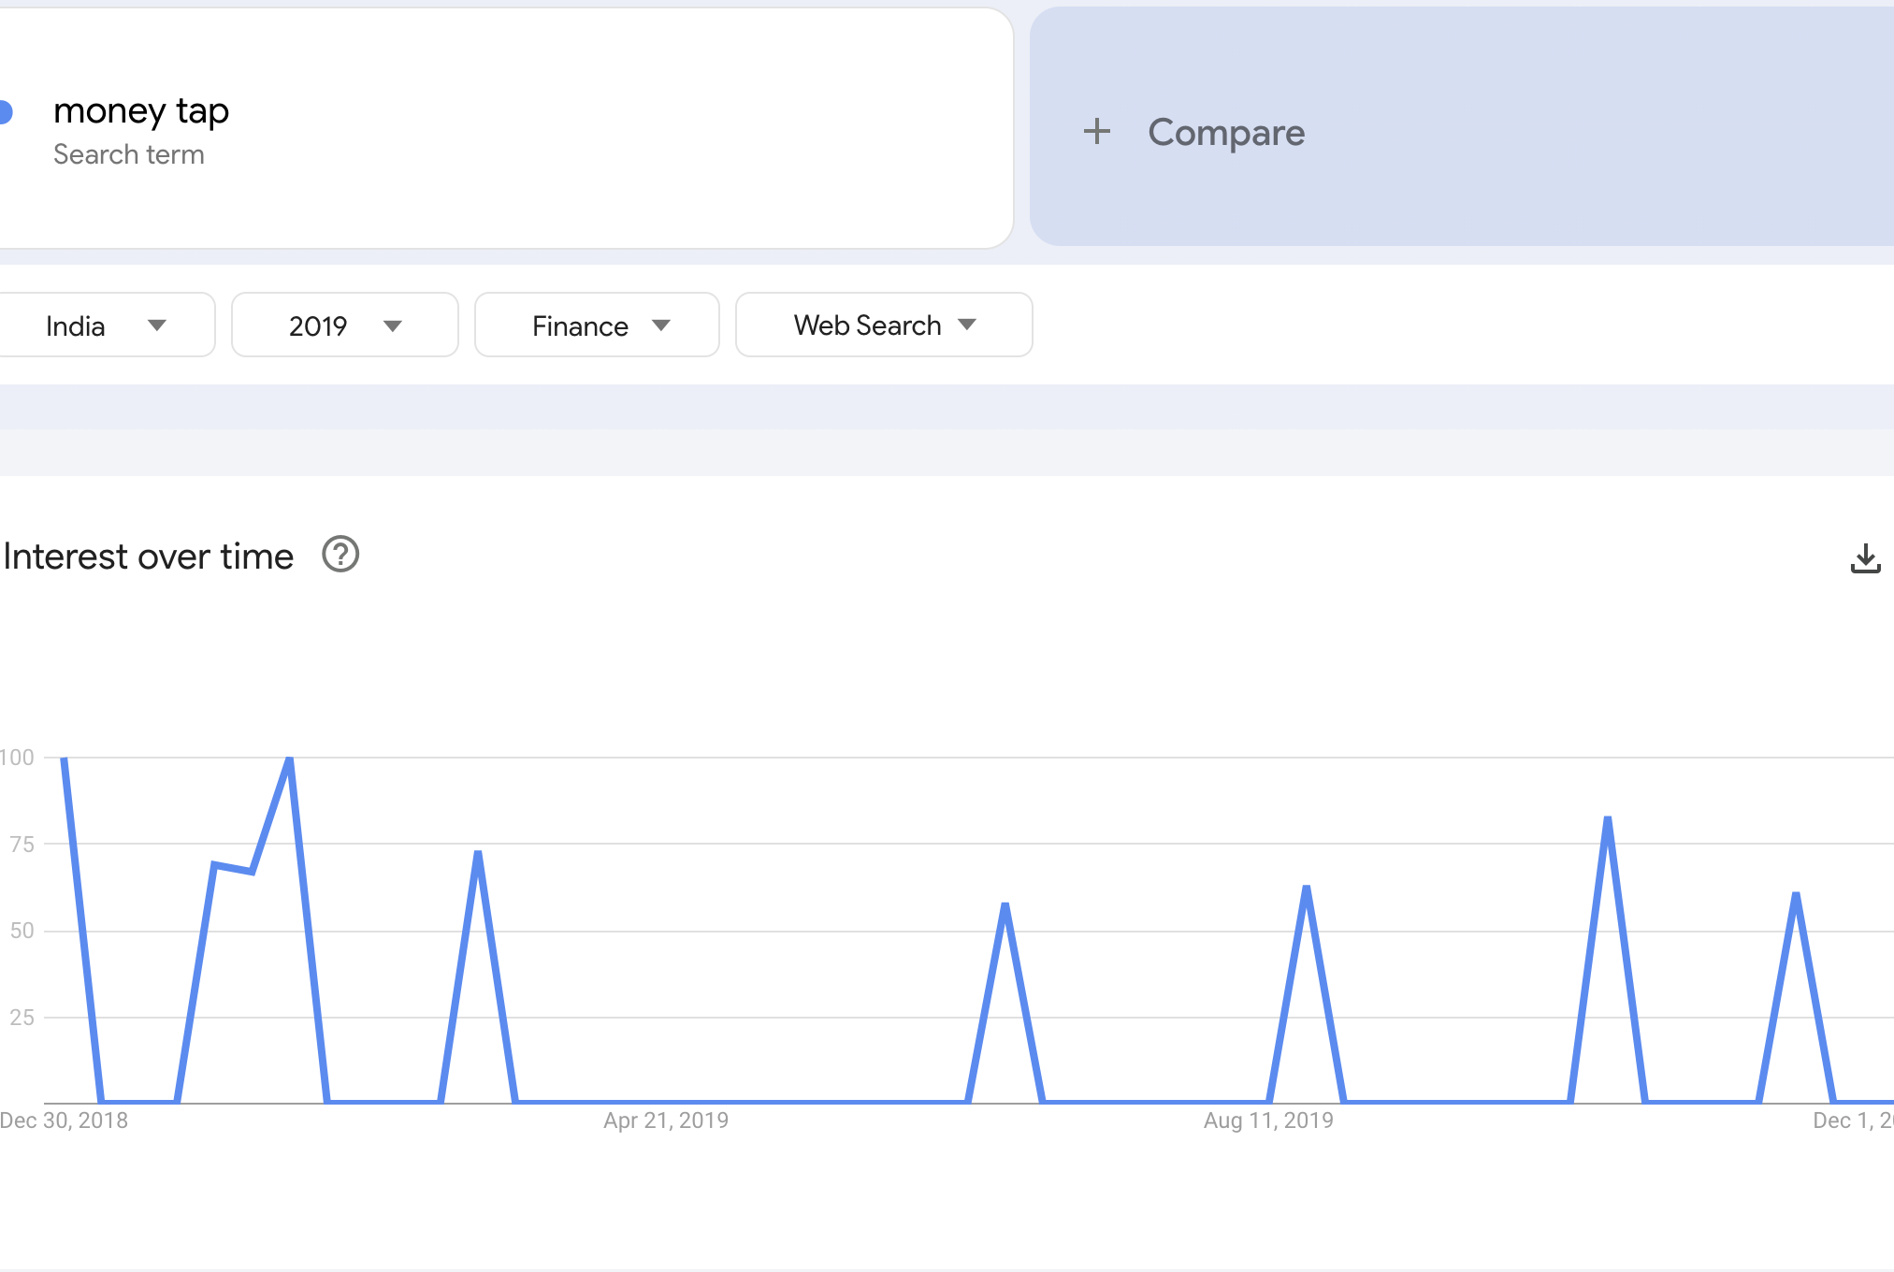
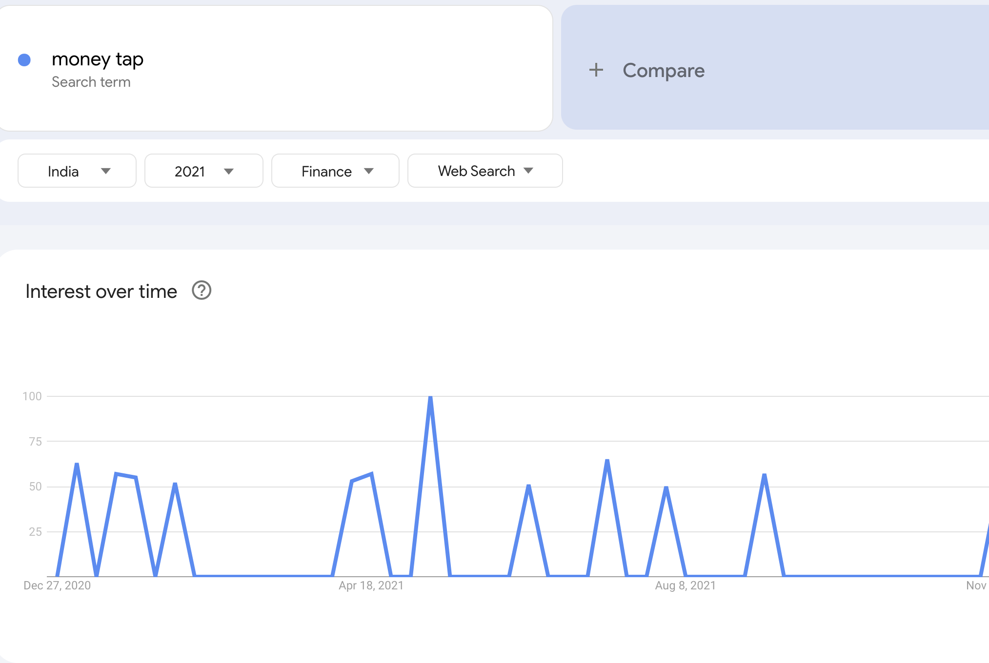
Search Traffic on MoneyTap
Notes:
Used Google trends to analyse the search traffic of MoneyTap (This image clearly indicates there is a good growth opportunity Indian market for the neo banks

Slide 17
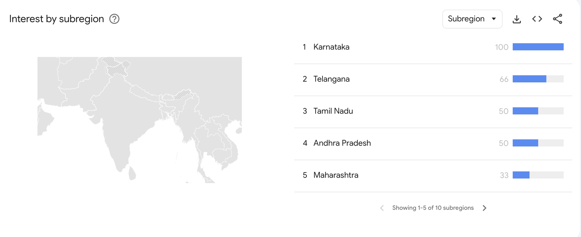
Interest analysis on Sub-Region!!
Notes:
Karnataka is more familiar with Moneytap as it is a startup from Bangalore. With no surprise,the Karnataka region is tend to be more familiar with the app

Slide 18
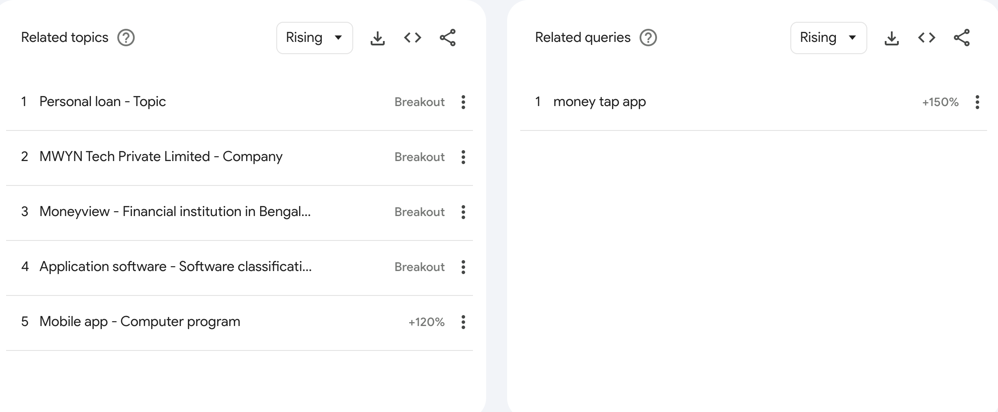
How do people look for MoneyTap online!!! (2019)
Notes:
Used Google Trends

Slide 19
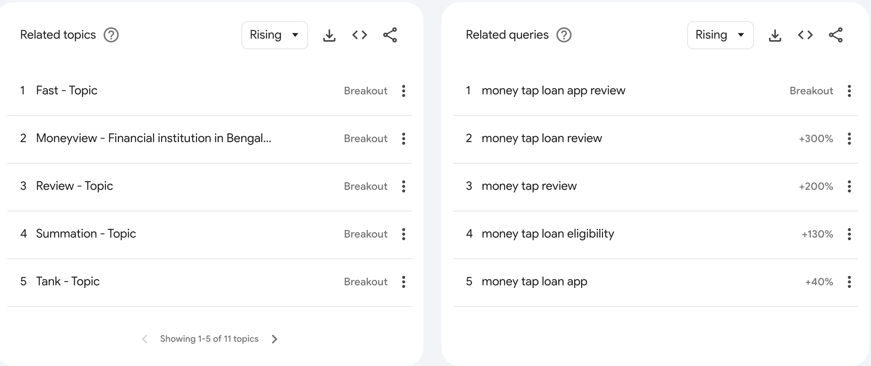
How do people look for MoneyTap online!!! (2021)
Notes:
(Used Google Trends) Compared to 2019 related queries have shown a distinct increase in the people’s interest

